Slide 1
MICRO CREDIT LOAN DEFAULTER PREDICTION
By
Satu Pole
Intern- Flip Robo Technologies

Slide 2
Problem Statement
A Microfinance Institution (MFI) is an organization that offers financial services to low income populations.
The dataset is related for one such client that is in Telecom Industry. They are a fixed wireless telecommunications network provider.
They are collaborating with an MFI to provide micro-credit on mobile balances to be paid back in 5 days. The Consumer is believed to be defaulter if he deviates from the path of paying back the loaned amount within the time duration of 5 days. For the loan amount of 5 (in Indonesian Rupiah), payback amount should be 6 (in Indonesian Rupiah), while, for the loan amount of 10 (in Indonesian Rupiah), the payback amount should be 12 (in Indonesian Rupiah).
Based on this data provided we need to build a machine learning model based on which company will select customers to give credit and also help them in future investments.

Slide 3
Exploratory Data Analysis- Introduction to dataset, finding duplicates and dropping unwanted columns
The dataset was uploaded from csv file. The dataset contained 209593 rows and 37 columns of which 1 column contains only index numbers hence it was dropped immediately.
Further the dataset was checked for duplicate entries in dataset and it was found that it contained 1 duplicate entry which was further removed.
Further 2 columns i.e. ‘pcircle’ and ‘msisdn’ were dropped. The reason being that ‘pcircle’ which meant telecom circle of all users had only 1 name of telecom circle and ‘msisdn’ consisted of mobile number of users. Since this kind of singular and random data is not usable for model building, hence they were dropped.

Slide 4
Exploratory Data Analysis- data cleaning and dropping columns
Since ‘pdate’ column which contained date cannot be used directly , it was seperated into 3 different columns I.e. day, month and year. They year column now contained data of only 2016 year, hence it was dropped from dataset with date column.
Further it was checked that columns had zero values for >90%, hence those columns were dropped. the columns that were dropped are 'last_rech_date_da', 'cnt_da_rech30', 'fr_da_rech30', 'cnt_da_rech90', 'fr_da_rech90', 'medianamnt_loans30', 'medianamnt_loans90'.
after checking value counts and its decription for ‘maxamnt_loans30’ column, it was noticed that this column should contains data either as 6, 12 or 0. Hence remaining data with values other than mentioned above were replaced with 0.

Slide 5
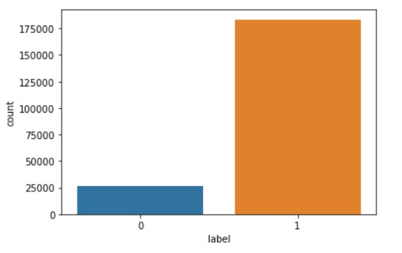
Exploratory Data Analysis- Visualization
The shown plot is of target column i.e. label.
The plot shows most of the people who took loan repayed on time while very less number of people are loan defaulters

Slide 6
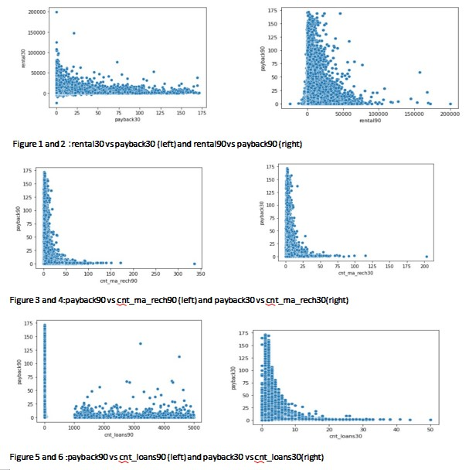
Exploratory Data Analysis- Visualization
Figure1: It can be seen from plot that if average main account balance over 30 days is less then average payback time in days for past 30 days increases.
Figure 2: It can be seen from the plot that if average main account balance over 90 days is less then average payback time in days for past 90 days also increases.
Figure 3: It can be seen from plot that if more number of times account got recharged in last 30 days then less then high number of payback time in days is seen.
Figure 4:It can be seen from plot that if more number of times account got recharged in last 90 days then less then high number of payback time in days is seen.
Figure 5: It can be seen that of number of loans taken by user in last 30 days is more then its payback time in days is also faster.
Figure 6: There is no general trend seen in this plot.The number of loans that taken by user in past 90 days are mostly paid back in approx. 0-25 days

Slide 7
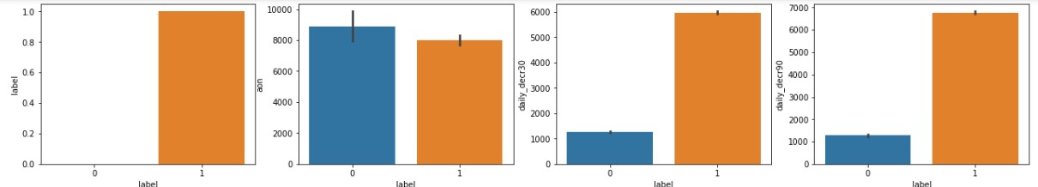
Exploratory Data Analysis- Visualization
Plot of label vs aon suggests that the loan defaulters age on cellular network in days is high compared to non defaulters age
Plot of label vs daily_decr30 and daily_decr90 suggests that daily amount spent from main account averaged over 30 and 90 days shows that most of the non-defaulters paid their amount within loan limit time while less number of defaulters i.e. around approx.>1000 did not pay loan amount within stipulated time.

Slide 8
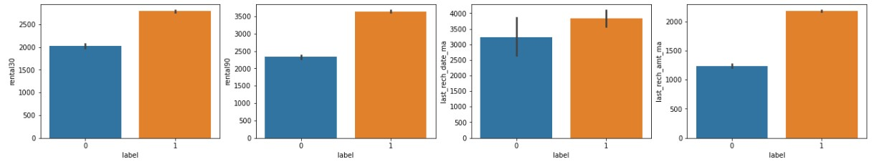
Exploratory Data Analysis- Visualization
Plot of label vs rental30 and rental90 suggests that main average account balance for 30 days incase of defaulters is almost 2000 while that of non-defaulters is >2500. Incase of average account balance for 90 days, defaulters is approx.2400 while that of non defaulters is >3500.
Plot of label vs last_rech_date_ma suggests that number of days till last recharge of main account is higher incase of non-defaulters while less in case of defaulters.
Plot of label vs last_rech_amt_ma suggests that Amount of last recharge of main account is higher incase of non-defaulters i.e.>2000 while incase of defaulters the amount is approx. 1250.

Slide 9
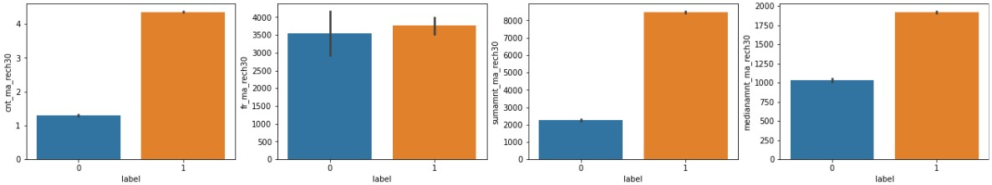
Exploratory Data Analysis- Visualization
Plot of label vs cnt_ma_rech30 suggests that >1 or single time main account of defaulters got recharged in last 30 days while incase of non defaulters the main account was recharged >4 times. The low rate of account recharge may suggest no payment of loans within 5 days.
Plot of label vs fr_ma_rech30 suggests that Almost equal number of people have the frequency of main account being recharged in last 30 days.
Plot of label vs sumamnt_ma_rech30 suggests that Total amount of recharge in main account over last 30 days is most for non-defaulters i.e. >8000 than >2000 for defaulters.
Plot of label vs medianamnt_ma_rech30 suggests that median amount of recharges done in past 30 days in indonesian rupiah is higher for non-defaulters i.e. approx.1800 while that for defaulters is lower i.e. approx. 1000 rupiah.

Slide 10
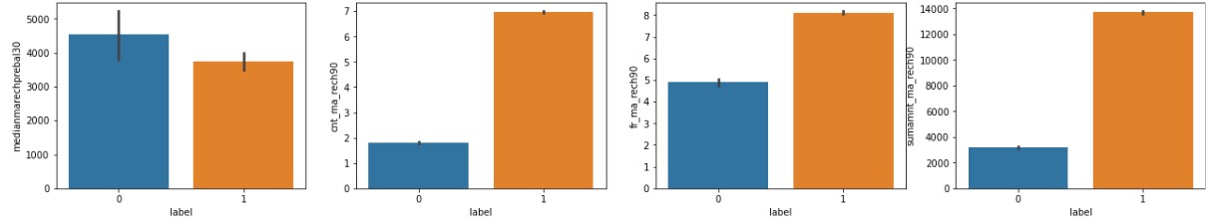
Exploratory Data Analysis- Visualization
Plot of label vs medianmarechprebal30 suggests that median of main account balance just before recharge for defaulters is higher i.e. approx. 4500 while that for non-defaulters is just over 3500 in indinesian rupiah.
Plot of label vs cnt_ma_rech90 suggests that >1 or 2 times main account of defaulters got recharged in last 90 days while incase of non defaulters the main account was recharged >6 times. The low rate of account recharge may suggest no payment of loans within 5 days.
Plot of label vs fr_ma_rech90 suggests that incase of defaulters the frequency of main account being recharged in last 90 days was 5 times while that incase of non-defaulters the frequency was 8 times.
Plot of label vs sumamnt_ma_rech90 suggests that Total amount of recharge in main account over last 90 days is most for non-defaulters i.e. >13000 than 3000 for defaultersin form of indonesian rupiah.

Slide 11
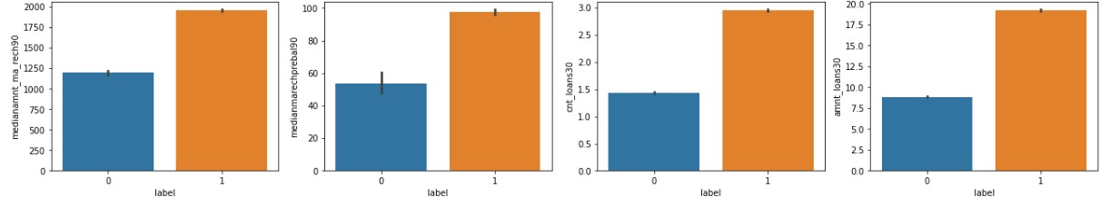
Exploratory Data Analysis- Visualization
Plot of label vs medianamnt_ma_rech90 suggests that median of main account balance just before recharge for defaulters is higher i.e. approx. 4500 while that for non-defaulters is just over 3500 in indinesian rupiah.
Plot of label vs medianmarechprebal90 suggests that median amount of recharges done in past 90 days in indonesian rupiah is higher for non-defaulters i.e. approx.2000 while that for defaulters is lower i.e. approx. 1250 rupiah.
Plot of label vs cnt_loans30suggests that defaulters took average of 1.5 loans in past 30 days while non- defaulters took average of 3 loans in past 30 days.
Plot of label vs amnt_loans30 suggests the total number of loans taken by defaulters is 8 time while that of non-defaulters is 18 times in past 30 days.

Slide 12
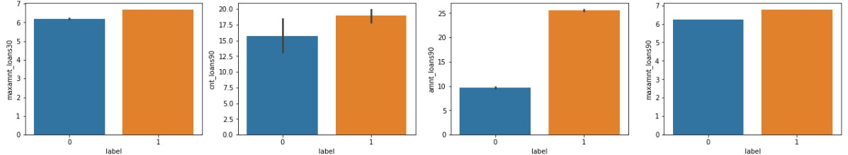
Exploratory Data Analysis- Visualization
Plot of label vs maxamnt_loans30 suggests the maximun amount of loans taken by defaulter is 6 times while that of non-defaulters is 7 times in past 30 days
Plot of label vs cnt_loans90 suggests that defaulters took average of >15 loans in past 90 days while non- defaulters took average of 18 loans in past 90 days.
Plot of label vs amnt_loans90 suggests the total number of loans taken by defaulters is 10 times while that of non-defaulters is 28 times in past 90 days.
Plot of label vs maxamnt_loans90 suggests the maximun amount of loans taken by defaulter is >6 times while that of non-defaulters is 7 times in past 90 days.

Slide 13
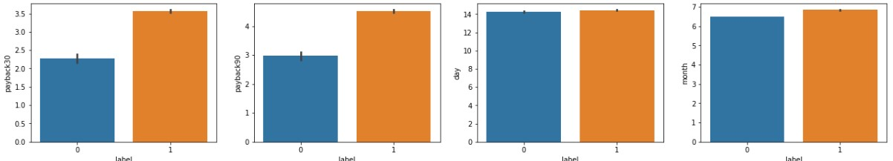
Exploratory Data Analysis- Visualization
Plot of label vs payback30 suggest that average payback time over days for 30 days is within 2-2.5 days for defaulters while that for non-defaulters is 3.5 times.
Plot of label vs payback90 suggest that average payback time over days for 30 days is within 3 days for defaulters while that for non-defaulters is >4 times.

Slide 14
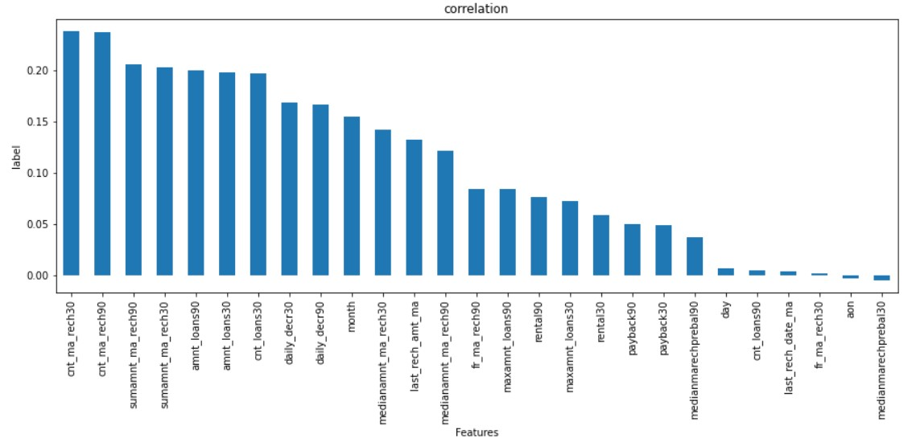
Exploratory Data Analysis- Visualization
As seen in above figure all the features shows positive corelation with label. Highest relationship with label is shown by ‘cnt_ma_rech30’ column.

Slide 15
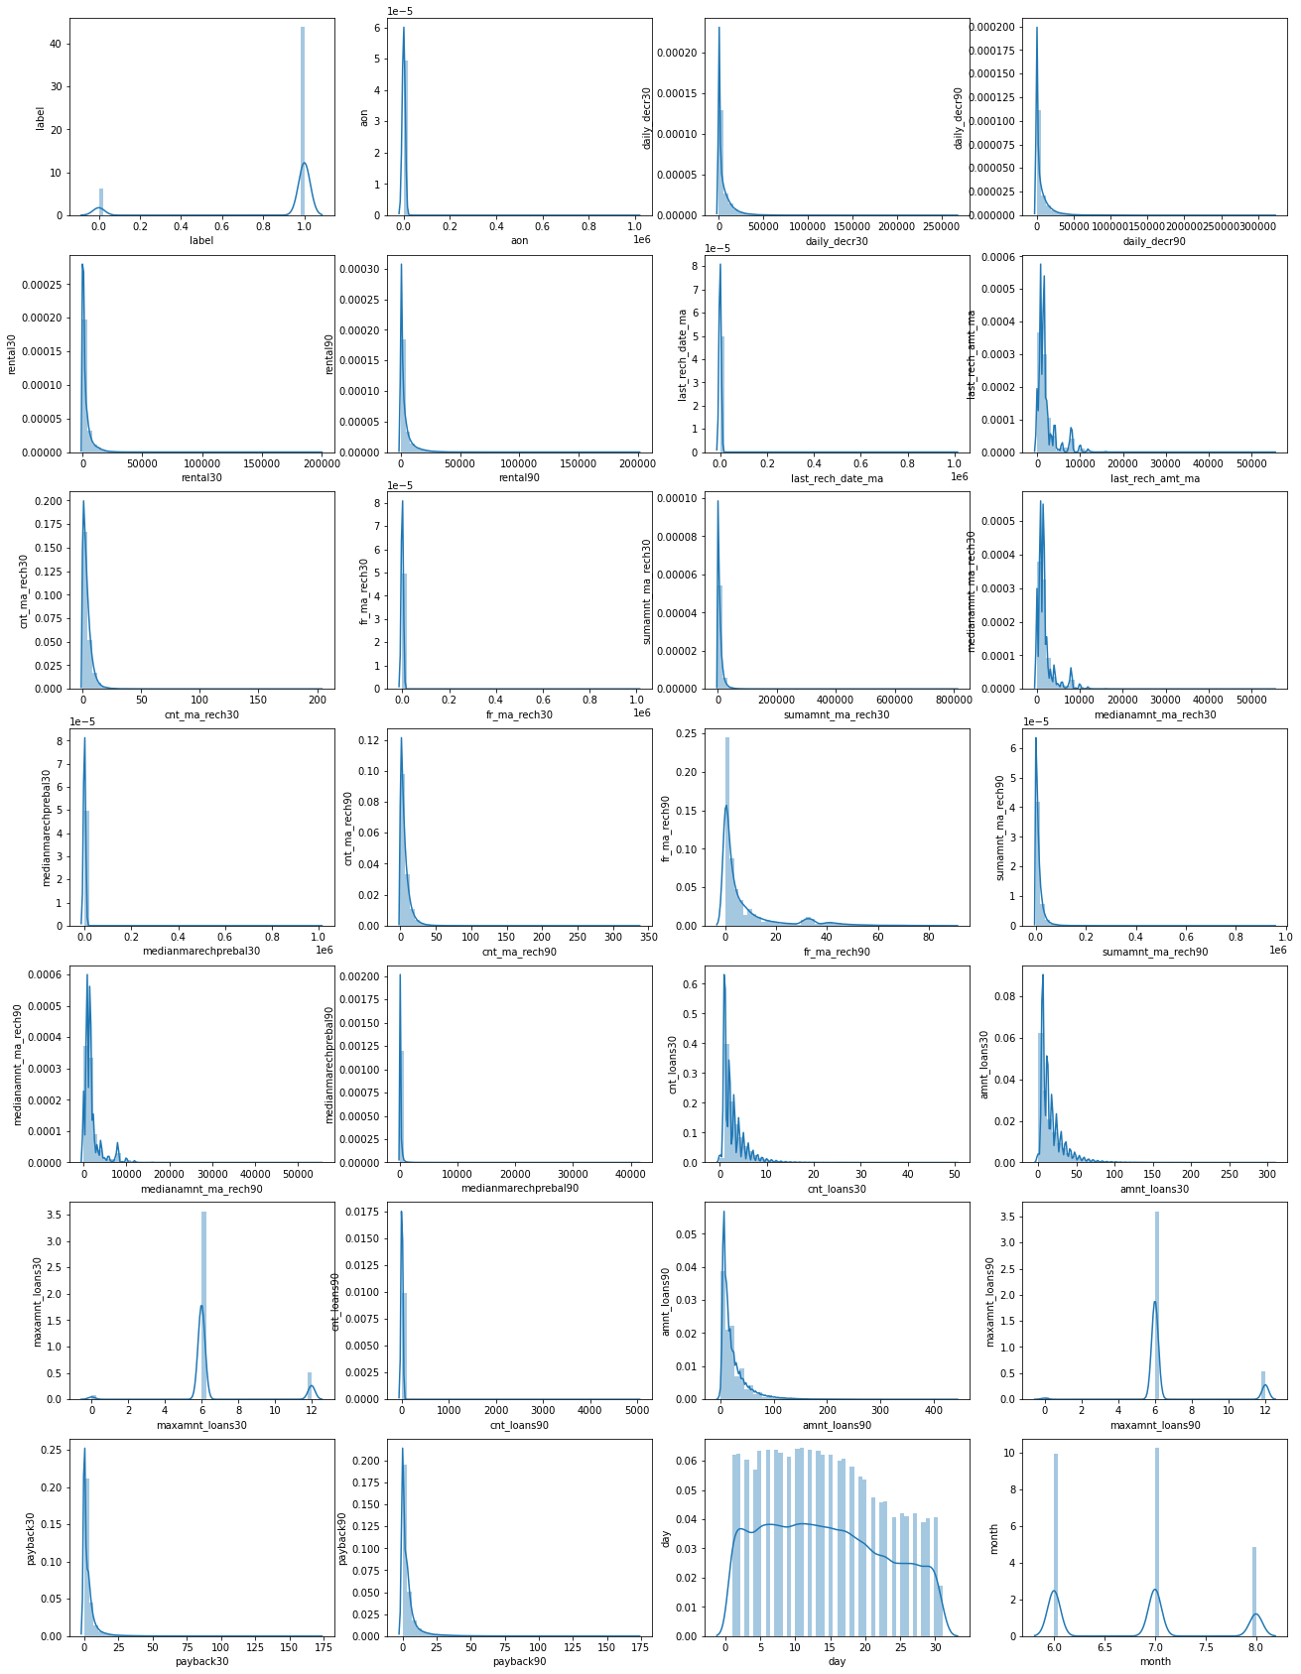
Exploratory Data Analysis- Visualization
It is seen that the data is highly skewed, hence data was further treated using power transformer method to remove/reduce skewness.

Slide 16
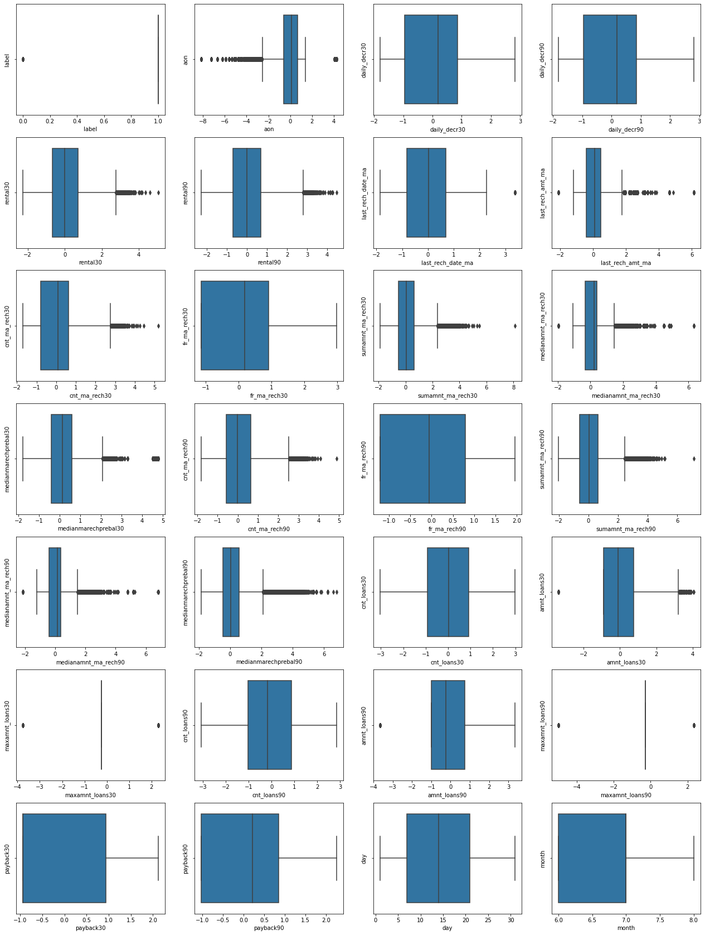
Exploratory Data Analysis- Visualization
Most of the columns in above plots has outliers which were further removed using z-score method

Slide 17
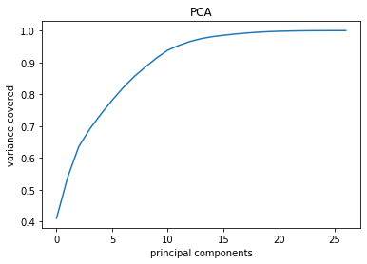
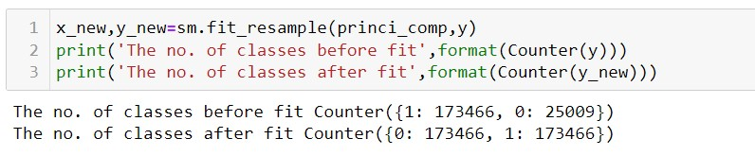
Exploratory Data Analysis- VIF,PCA and SMOTE
- After using VIF to find multicollinearity, it was seen that too many columns showed multicollinearity. But deleting all those columns might have hampered model accuracy so PCA was used.
- Above curve shows that at 20 features, almost 95-100% data is covered, hence 20 features were taken for model building.
- Since label (target) column was imbalanced, SMOTE method was used to balance dataset.

Slide 18
Algorithms used for model making
The algorithms that were used in model building are:
Random Forest Classifier (rf)
Xtreme Gradient Boosting (xgb)
AdaBoost Classifier (ab)
Logistic Regression (lr)
Gradient Boosting Tees Classifier (gbdt)
6.Decision Tree Classifier(dt)

Slide 19
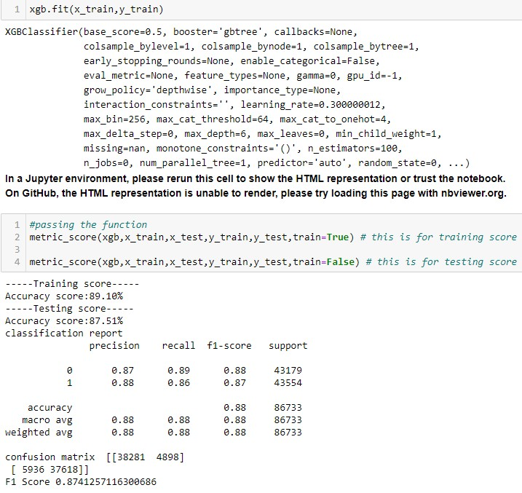
ML models: XGB
The xgb model provided testing accuracy of 87.51% with cross validation and F1 score as 87.61 and 87.41 respectively.

Slide 20
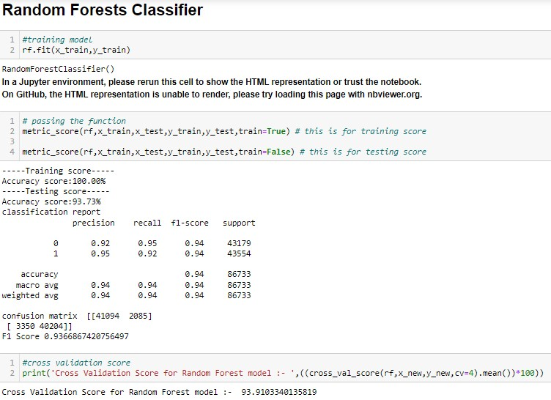
ML models: Random Forest
The Random Forest model provided testing accuracy of 93.73% with cross validation and F1 score as 93.91 and 93.66 respectively.

Slide 21
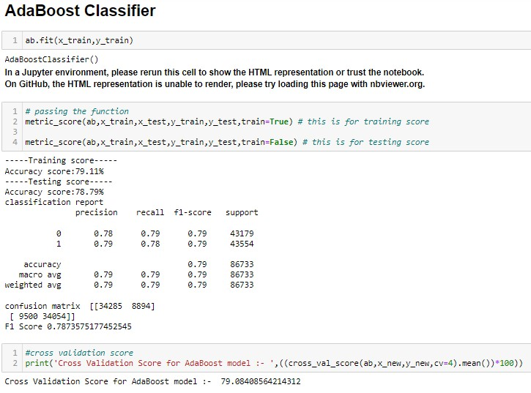
ML models: AdaBoost
The Adaboost model provided testing accuracy of 78.79% with cross validation and F1 score as 79.08 and 78.73 respectively.

Slide 22
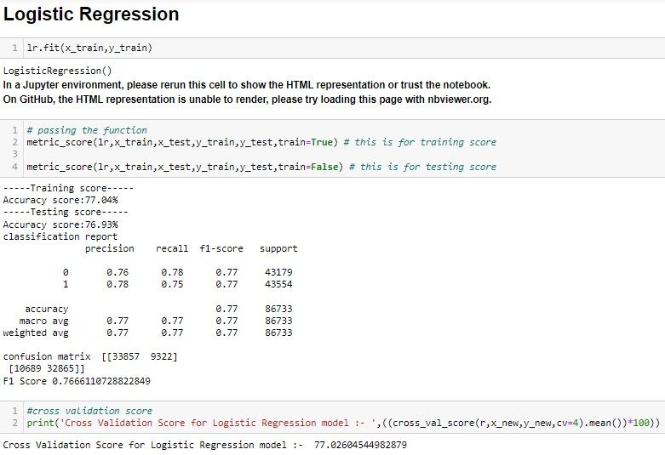
ML models:Logistic Regression
The Logistic Regression model provided testing accuracy of 76.93 %with cross validation and F1 score as 77.02 and 76.66 respectively.

Slide 23
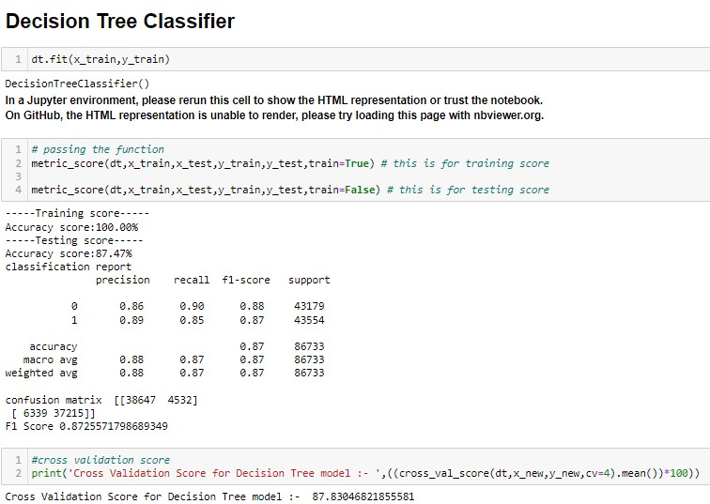
ML models:Decision Tree
The decision tree model provided testing accuracy of 87.47% with cross validation and F1 score as 87.83 and 87.25 respectively

Slide 24
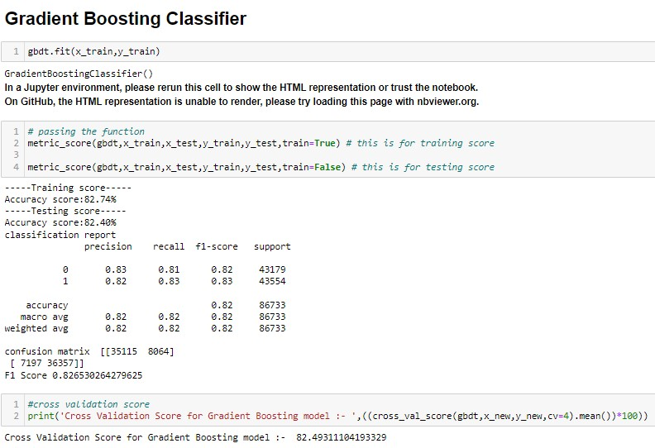
ML models:Gradient Boosted Decision Trees
The gradient boosted tees model provided testing accuracy of 82.40% with cross validation and F1 score as 82.49 and 82.65 respectively.

Slide 25
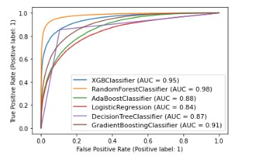
ML Models- ROC curve with AUC score
Looking at above curves it can be seen that Random Forest Classifier model covers most of the area. Hence according to this Random Forest model is the best model.

Slide 26
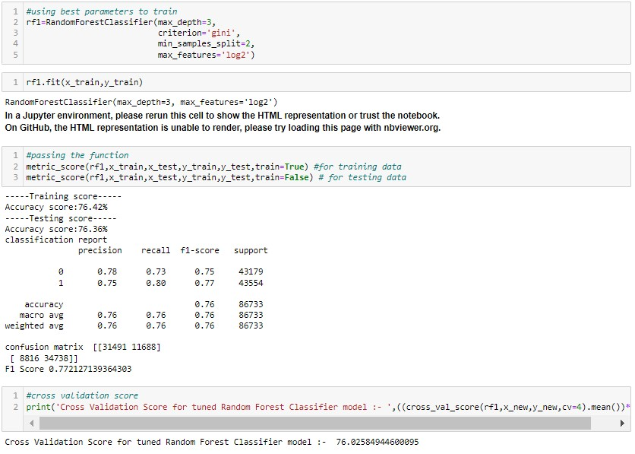
ML Models- Hyperparameter tuning
The tuned model had low accuracy then the original model, hence original Random Forest Classifier model was selected as the best model.

Slide 27
Key Metrics Used to Understand Models
• Accuracy score means how accurate our model is that is the degree of closeness of the measured value to a standard or true value.
• F1 Score is used to express the performance of the machine learning model (or classifier). It gives the combined information about the precision and recall of a model. This means a high F1-score indicates a high value for both recall and precision.
• Cross Validation Score is a technique used to protect against overfitting in a predictive model, particularly in a case where the amount of data may
be limited.
• Roc Auc Score: The Receiver Operator Characteristic (ROC) curve is an evaluation metric for binary classification problems. It is a probability curve that plots the TPR against FPR at various threshold values. The Area Under Curve (AUC) is the measure of the ability of a classifier to distinguish between classes and is used as a summary of the ROC curve

Slide 28
Conclusion
The following findings were seen from dataset:
From the whole study I found that the MFIs have provided loan to the user who have no recharge or balance in their account which needs to be stopped.
Also, the frequency of main account recharged in last 30 days & 90 days we have seen the users with low frequency are causing huge losses, company should implement some kind of strategies to reduce like sending SMS alerts for notification.
I also found the defaulting rate is higher in old customers list.

Slide 29
Thank you

